Slide 1

Hotel booking System
Created by:
Ami Purohit
Kalpesh Patel
Miral Patel

Slide 2
Uml

Slide 3
Major functionality
Implementation of Interface class
Implementation of Abstract class
Working with inhertance
Using text I/O class
Using ArrayList class
Working with Exception Handling

Slide 4
Future Modification
Add database connection.
Add GUI option.
Log Employee information.
Create more search option.
Can add more validation option

Slide 5

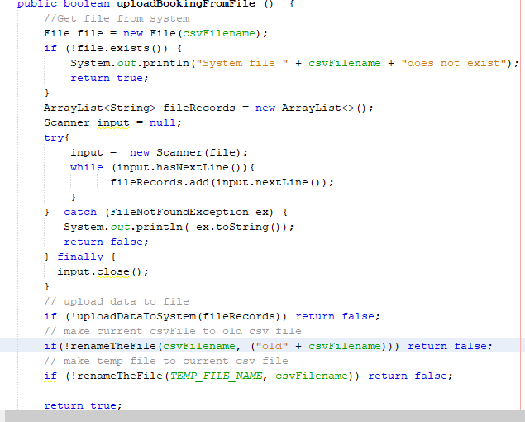
Retrieving data from csv file
Retreveing record from system
Add record to system ArrayList
Copy app records to temp file
Rename csv file to old csv file for reference
Rename temp file as new csvFile

Slide 6
The end
Thank you

